Slide 1

P24_NAOP Personality classification problem
Team2
Name: Swathi
Megha
Rohith
John
Akshay

Slide 2
Business Problem:
Business objective-
The NAOP( National Academy of psychology of India) which studies about the human psychology, has manually segregated the people’s personality into categories like A,B,C,D.

Slide 3
Project Architecture / Project Flow
1.Understanding Business Objective
2.Getting data set details
3.EDA:Exploratory Data Analysis
4.Model Building
5.Evaluate the model
6.Data Visualizations
7.Deployment Frame

Slide 4
Exploratory Data Analysis (EDA) and
Feature Engineering

Slide 5
Data set details
Dataset contain 3 columns and 1000 rows -
1st column is “ Unnamed : 0 ” with serial numbers with the count of row.
2nd column is “ Types “ which is the types of personalities ie A,B,C&D.
3rd column is “ Posts “ which is the collection of texts which the personalities used in various platforms.
Dtype is int64

Slide 6
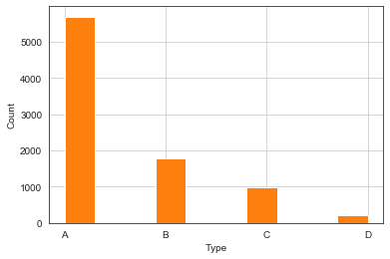
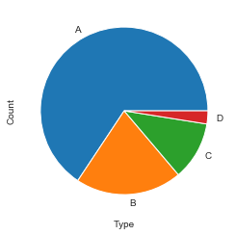
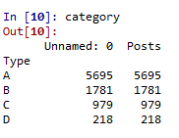
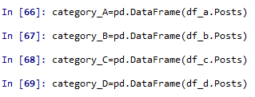
Dataset in graphs

Slide 7
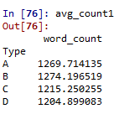
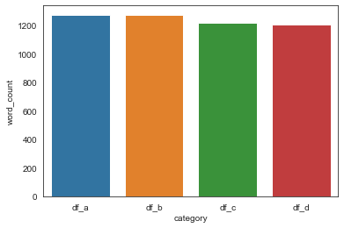
Average Word count in all categories

Slide 8
Data Pre-processing steps
EDA
removing punctuations & Whitespaces
removing stop words
Lemmatization
Top 20 Frequent words
word cloud generation
top 10 bigrams
TFIDF matrix
Sentimental Analysis

Slide 9
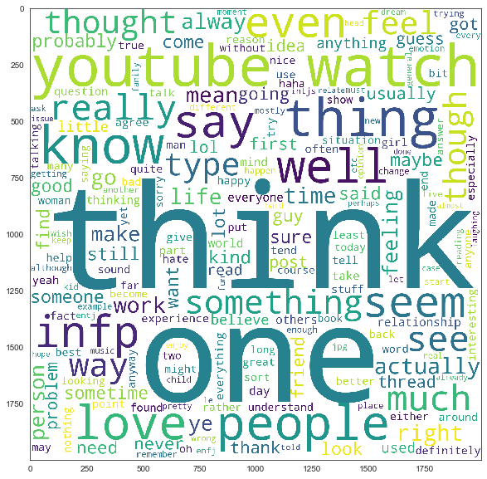
Category-A talks and stressed about think, one, youTube, watch, love, people, feeling and etc
Word Cloud – Category (A)

Slide 10
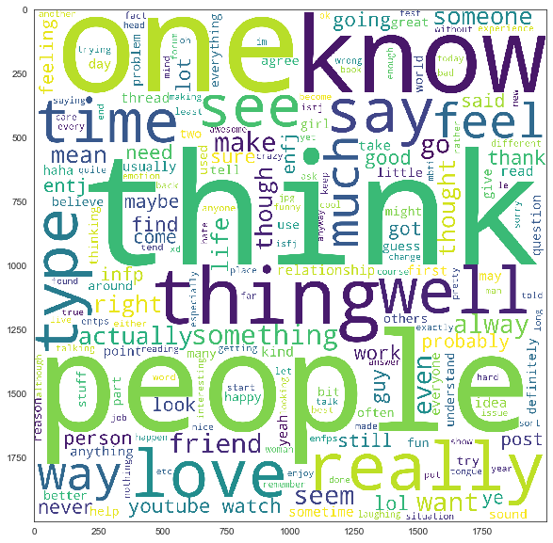
Word Cloud – Category (B)
Category-B talks and stressed about people, think, one, thing, really, love, know, something, time and etc…
EXCELR

Slide 11
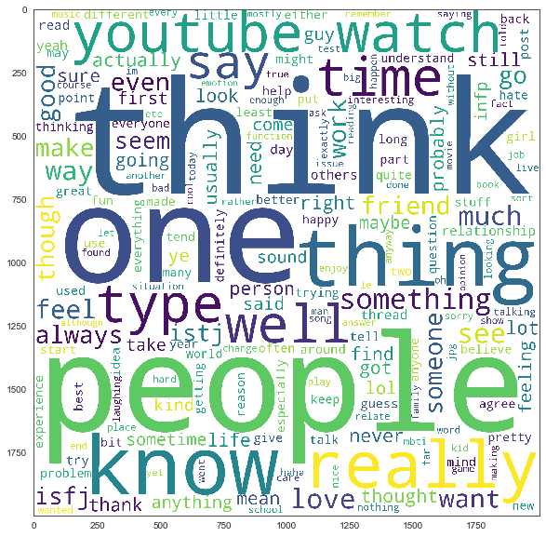
Word Cloud – Category (C)
Category-C talks and stressed about think, people, one, thing, really, know, youtube, watch, and etc…
EXCELR

Slide 12
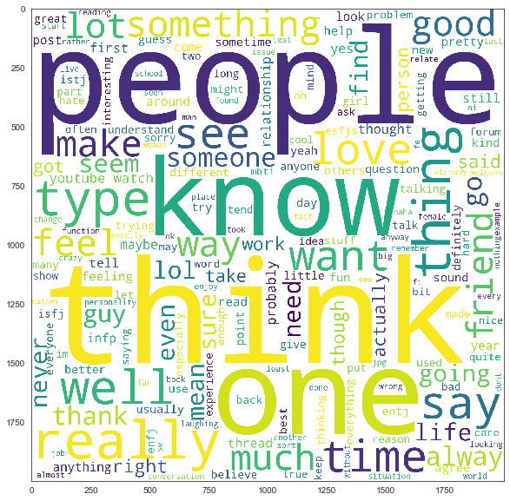
Word Cloud – Category (D)
Category-D talks and stressed about think, people, one, thing, know, type, time, love, and etc…
EXCELR

Slide 13
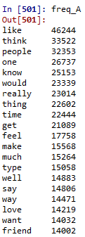
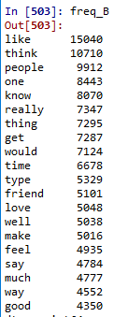
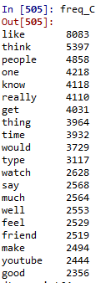
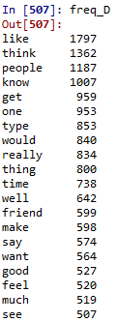
Top 20 Frequent words in all four categories

Slide 14
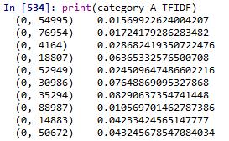
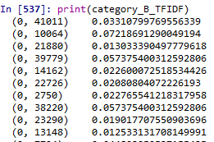
TFIDF of all Four Categories
Term Frequency and Inverse Document Frequency
from sklearn.feature_extraction.text import TfidfVectorizer

Slide 15
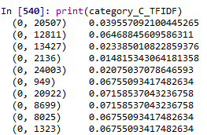
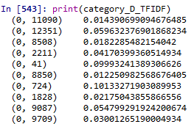

Slide 16
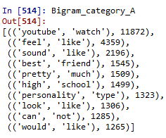
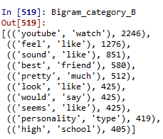
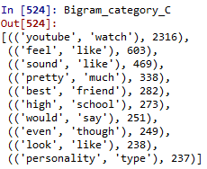
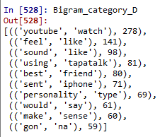
Bigrams for all four categories

Slide 17
Sentimental Analysis
Sentiment analysis is the interpretation and classification of emotions (positive, negative and neutral) within text data using text analysis techniques. Sentiment analysis - Done by TextBlob library
All the category of class A,B,C and D shows a positive polarity with a small slight of neutral behaviour.
The polarity graph is shown below.

Slide 18
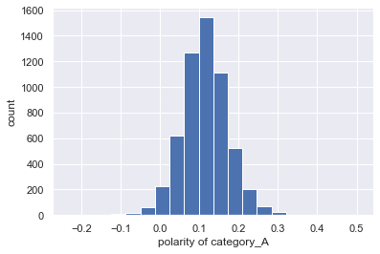
Most of the observation in category_A is positive. Positive polarity reaches till 0.3 and negative polarity stops before -0.1
Sentimental Analysis of Category (A)

Slide 19
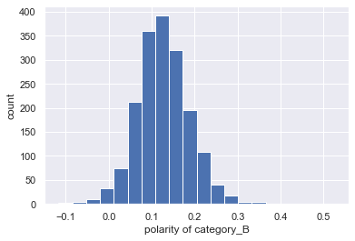
Sentimental Analysis of Category (B)
Most of the observation in category_B is positive, and positive polarity almost getting near to 0.4 and negative polarity stops before -0.1

Slide 20
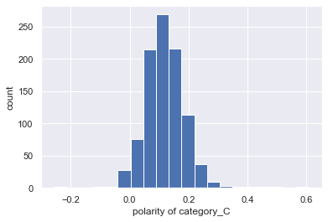
Sentimental Analysis of Category (C)
Most of the observation in category_C is positive, and positive polarity almost getting near to 0.4 and negative polarity stops at -0.1

Slide 21
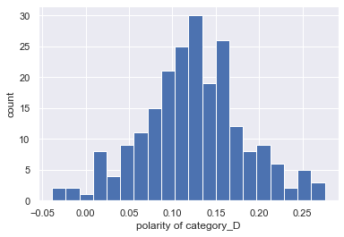
Sentimental Analysis of Category (D)
Most of the observation in category_D is positive, and positive polarity almost getting near to 0.3 and negative polarity stops before -0.05.

Slide 22
Model Building

Slide 23
Model Building
Following are the models used for Model building in this project:
1)Logistic regression.
2)Decision tree classifier.
3) Random forest classifier.
4) Naive Bayes classifier .
5) Support Vector Machine(SVM) Classifier.
6)Neural Networks
7)Bagging classifier method.
8)LSTM

Slide 24
Model building Output
we tried all the models which is shown about and got accuracy which is above 70%.
But the challenge faced is the f1-score of the type D which is very low compared to the other types A,B,C.
Type D which shows the Imbalance data can be removed by applying smote technique which help to solve the class imbalance problem.
After applying smote the class imbalance is solved and the f1-score have changed and the accuracy is maintained is some model.
Logistic Regression is the model which shows high accuracy compared to other models.
we use Logistic Regression for model building and model deployment.

Slide 25
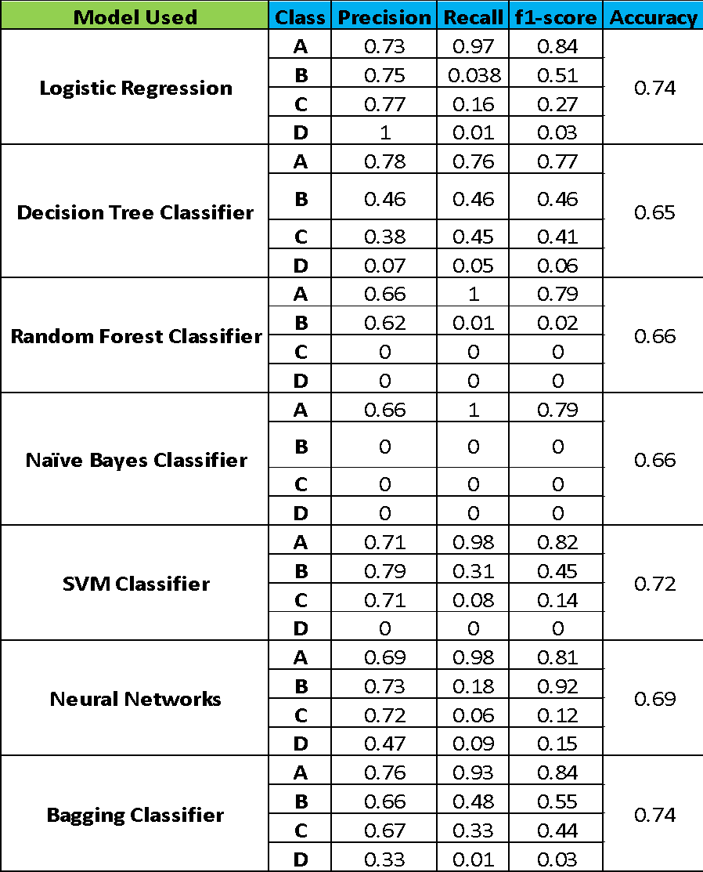
Model building Results before SMOTE:
Observation: From the results off all the classification models we can infer that there is a class imbalance problem in the data set.
How to solve Class Imbalance?
By using SMOTE technique we are trying to solve class imbalance problem
SMOTE : stands for Synthetic Minority Oversampling Technique. This is a statistical technique for increasing the number of cases in your dataset in a balanced way. The module works by generating new instances from existing minority cases that you supply as input.

Slide 26
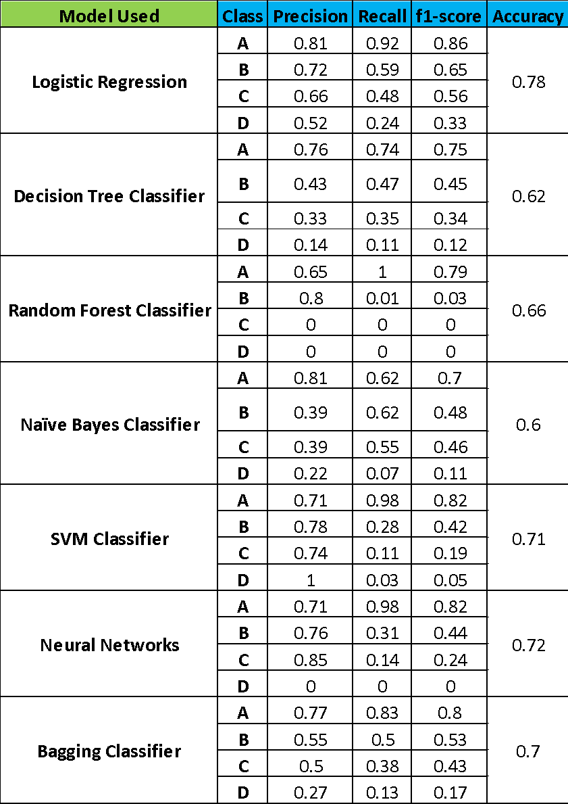
Model building Results after SMOTE:
Observation: From the results we finalized Logistic Regression as our final model and it is used in model deployment part

Slide 27
LSTM
We tried with deep learning model to find accuracy. But LSTM accuracy is less than 70 with respect to Logistic Regression.

Slide 28

Model Evaluation
Once we are done with training our model, we cant be sure that the model will have the desired accuracy and variance in production environment.
For this, we need to validate our model. To evaluate the performance of any machine learning model we need to test it on some unseen data.
Cross validation (CV) is one of the technique used to test the effectiveness of a machine learning models, it is also a re-sampling procedure used to evaluate a model if we have a limited data.

Slide 29
Few common techniques used for CV
Train_Test Split approach.
We can manually split the data into train and test set using slicing or we can use the train_test_split of scikit-learn method for this task
K-Folds Cross Validation:
K-Fold is a popular and easy to understand
it generally results in a less biased model compare to other methods.
it ensures that every observation from the original dataset has the chance of appearing in training and test set.

Slide 30

Model Deployment using

Slide 31
Model Deployment
The Model Deployed is Logistic Regression.
For deployment we have created files like app.py, Transform.pkl and Model.pkl.
Here TFIDF matrix saved as Transform.pkl and Logistic Regression(Higher Accuracy Model) saved as to Model.pkl.
And app.py is the Flask deployment code.

Slide 32
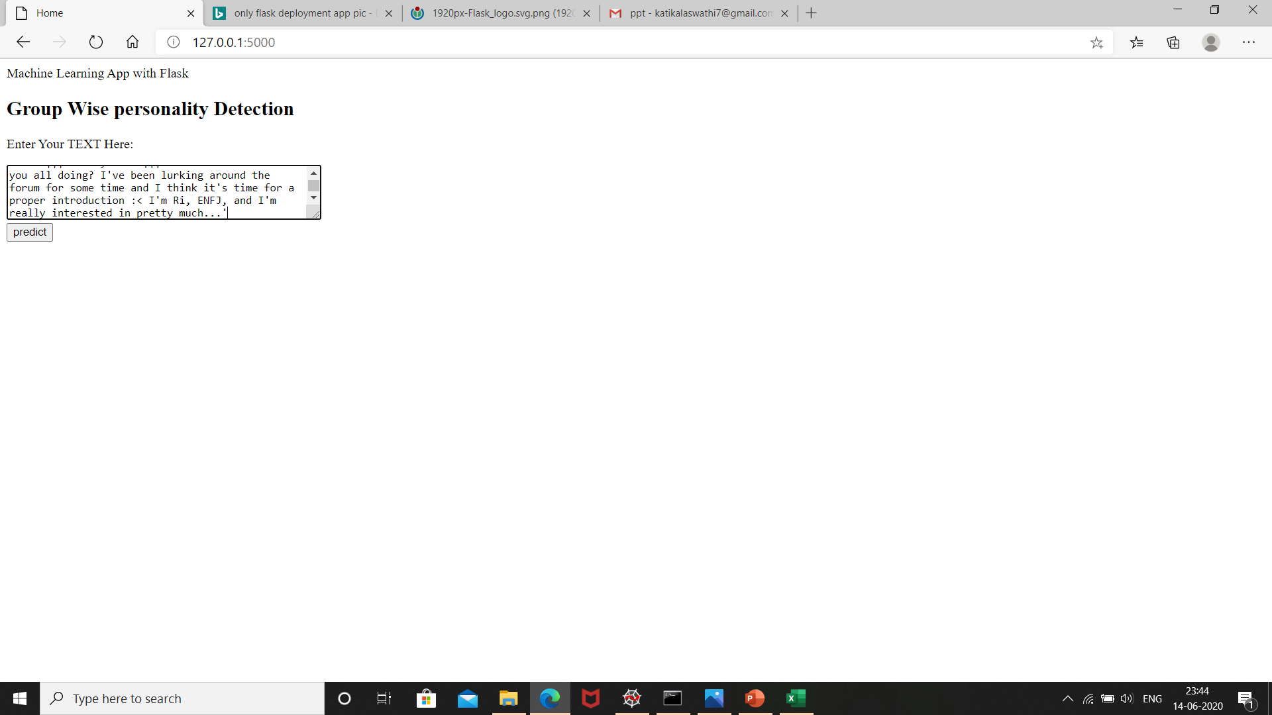
Results:
Home Page

Slide 33
Deployment Using flask
Flask File Creation:
Import Flask from flask module
Create an instance of the Flask class
Using @app.route(‘/’) to execute home function which gives home page for this use home.html
Using @app.route(‘/predict’, methods=[POST]) to execute predict function which gives results page for this use result.html
After execute whole deployment code it gives link like http://127.0.0:5000 run this link to get results.

Slide 34
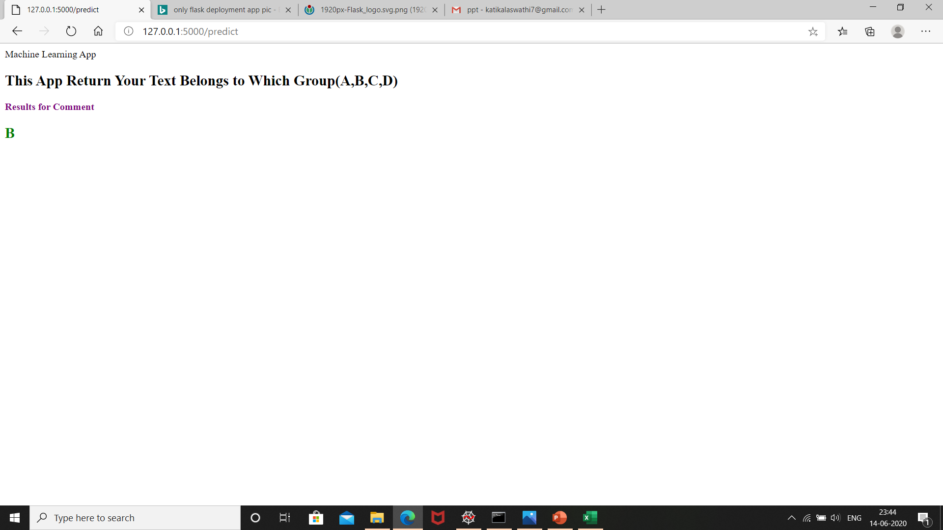
Result Page

Slide 35
Deployment Using Heroku
https://apptoday3.herokuapp.com/

Slide 36
Thank you

